Slide 1
UCSD Embedded Linux Assignment 1
By
Hsuankai Chang
hsuankac@umich.edu

Slide 2
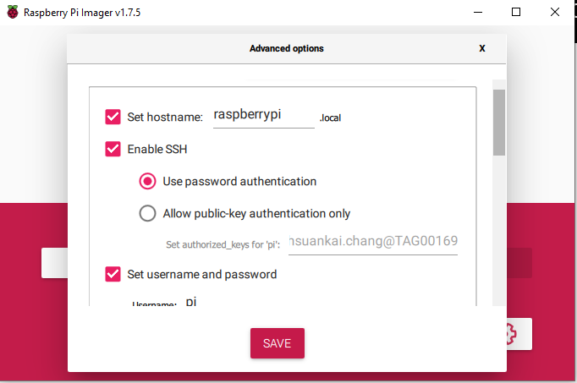
Step 1. Flash the image file of the raspberrypi using rasperrypi imager into the micro sd card. Since I am using the headless connection way, I will have to enable to SSH connection in the advanced settings. Noted that I still set my raspberrypi as default username: pi and password: raspberry.

Slide 3
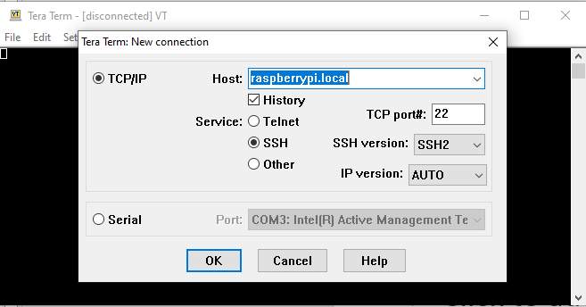
Step 2. After writing the image to the SD card is complete, plug the SD card into raspberrypi, connect the power and ethernet cable. Start the power and use tera term to log into the raspberrypi.

Slide 4
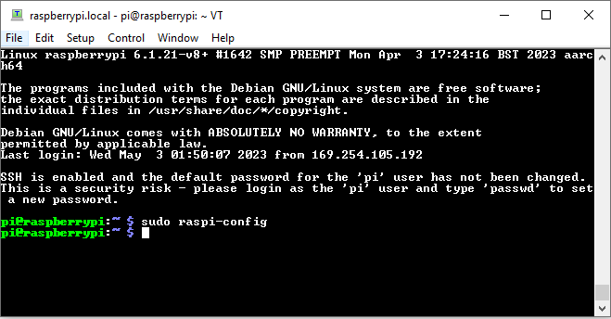
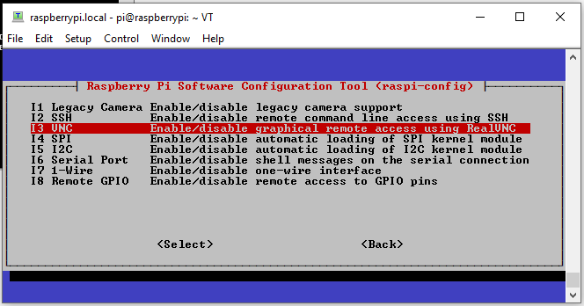
Step 3. Type the username and password for the pi, then enable the VNC connection by typing in sudo raspi-config. Then go to interface options, VNC, choose yes to enable

Slide 5
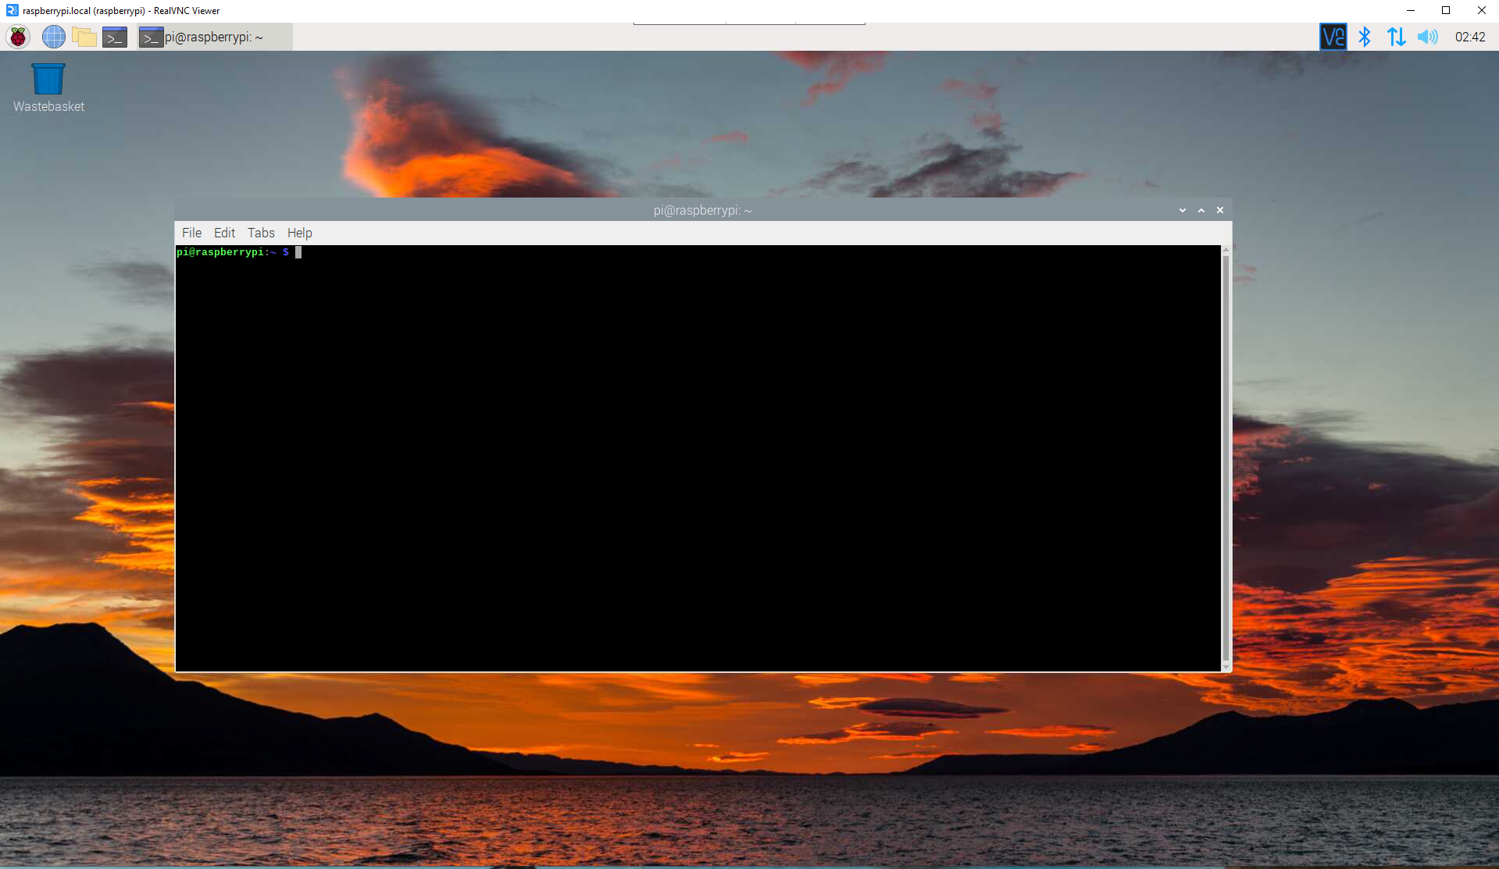
Step 4. Install VNC software, then log into the PI. Username and password is the same as SSH log in

Slide 6
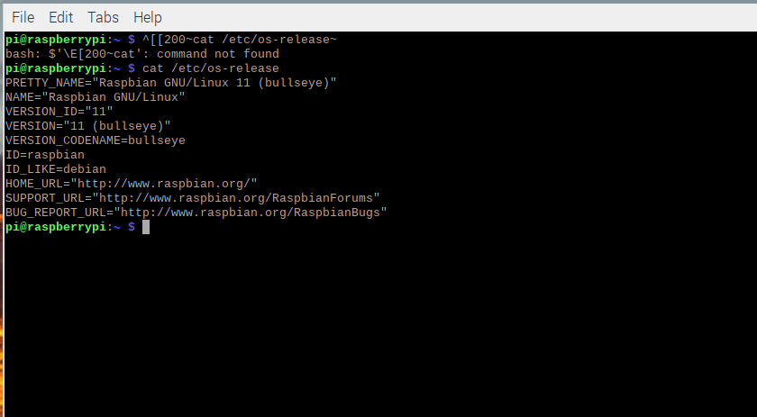
Step 5. Output for the command cat /etc/os-release

Slide 7
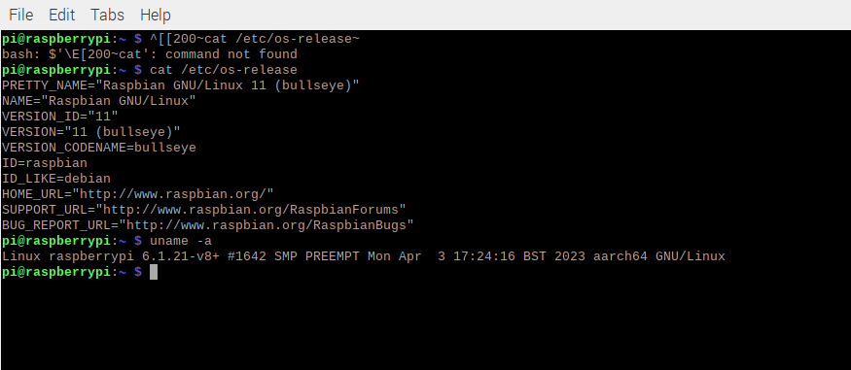
Step 6. Output for the command uname -a

Slide 8
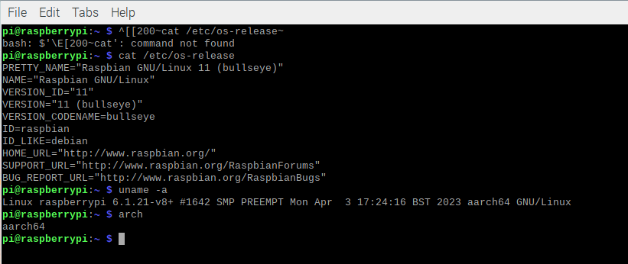
Step 7. Output for the command arch

Slide 9
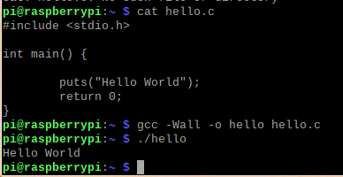
Step 8. Build and run the hello.c file, test is successful

Slide 10
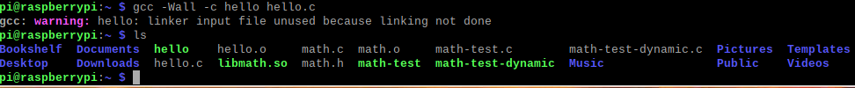
Step 9. Try to build the hello.o file, test is successful

Slide 11
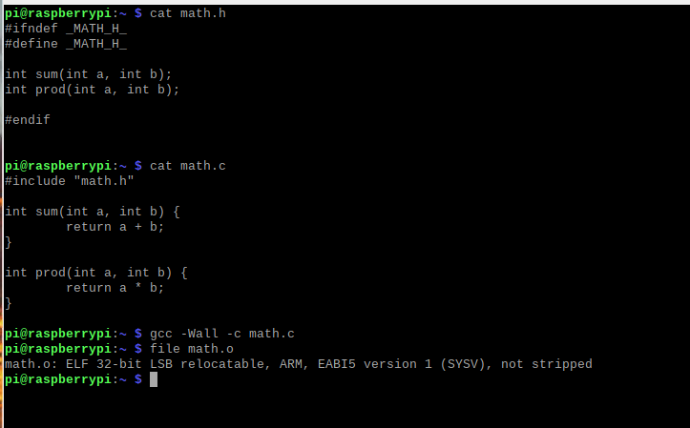
Step 10. Show your math.h, math.c source code and also the commands/output of building and running of the code

Slide 12
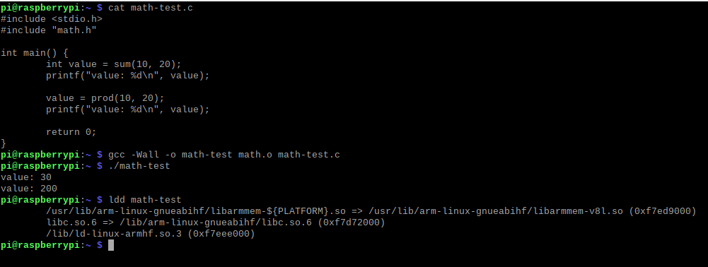
Step 11. Show your math-test.c source code and also the commands/output of building and running of the code

Slide 13
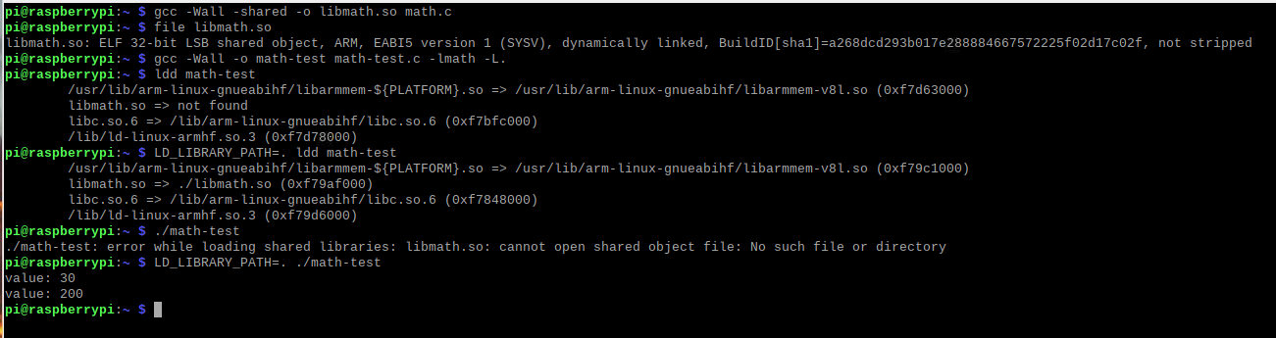
Step 12. Show your commands for creating libmath.so. Compile math-test.c and libmath.so

Slide 14
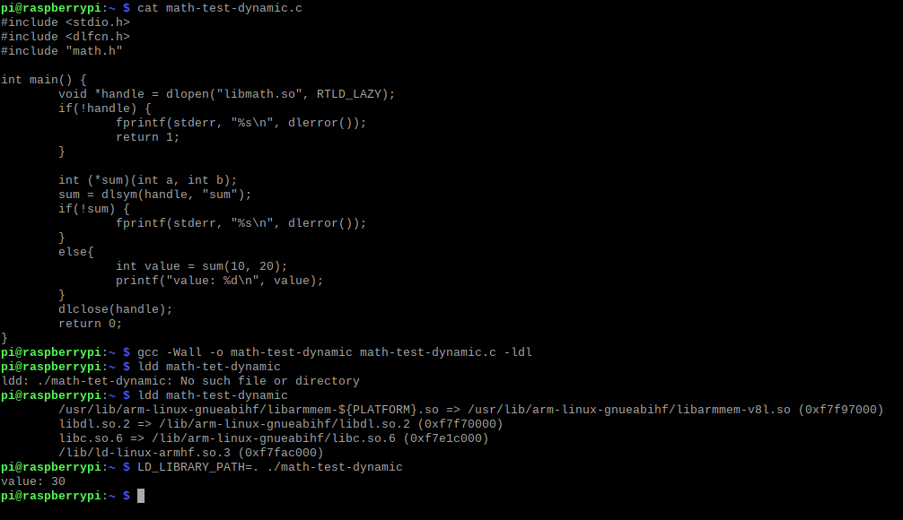
Step 13. Show your math-test-dynamic.c source code and also the commands/output of building and running of the code

